Slide 1
American Cultures Research Paper

Slide 2
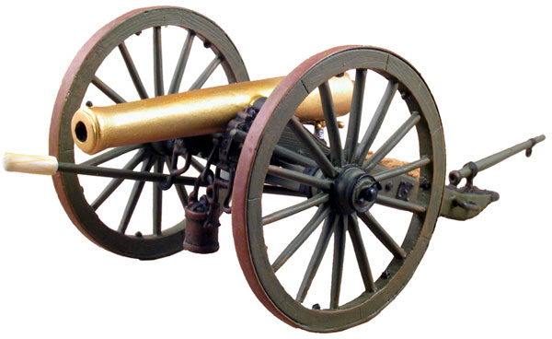
Choosing Topics
Pick any topic from the conflict we are discussing in class.
Choose a topic which interests you personally.
All topics must be approved by the teacher prior to research commencement.

Slide 3
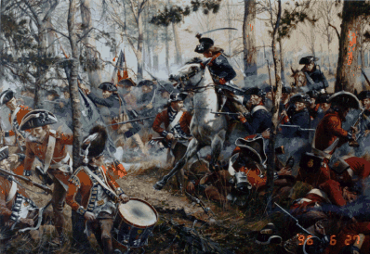
Choosing Topics
Categories to Consider:
People
Places
Battles
Technology
Weapons

Slide 4
Develop a Thesis
What is a thesis statement?
makes a supportable claim about the subject
CANNOT be a common fact, must be arguable
Example: The Americans won the Revolution
Good or bad thesis?????

Slide 5
Develop a Thesis
Here’s an example:
Paper Subject: Napoleon’s Demise
Thesis (should be arguable):
The demise of Napoleon can be attributed to three main factors.

Slide 6
The Forecast
Is a road map for the paper
Tells the reader what to expect from the rest of the paper
Example: A combination of abrasive foreign policies, the Russian campaign, and personal overconfidence all led to Napoleon’s downfall.

Slide 7
Where does the Thesis and Forecast go???
The last two sentences of your introduction.
Thesis first
Forecast second

Slide 8
Example Intro
The reign of the French emperor Napoleon Bonaparte may have only lasted for a brief time in the history of the European continent but had profound effects. European countries needed to form alliances to combat the French war machine, a tradition which continues in some forms today. Through these alliances the allied European countries defeated Napoleon, but not by sheer military might alone. The demise of Napoleon can be attributed to three main factors. A combination of abrasive foreign policies, the Russian campaign, and personal overconfidence all led to Napoleon’s downfall.

Slide 9
Forecast as a Road Map
According to the example thesis from last slide:
Introductory Paragraph
(includes your thesis and forecast)
Body Paragraph(s) 1 Abrasive Foreign Policies
Body Paragraph(s) 2 The Russian Campaign
Body Paragraph(s) 3 Personal Overconfidence
Closing Paragraph (restates your thesis)

Slide 10
Topic Sentences
Each of your three body paragraphs should start with a topic sentence.
Same order as your forecast
Body paragraph 1:
Abrasive foreign policies contributed greatly to the collapse of Napoleon’s French Empire.

Slide 11
What is a Primary Source?
They are created by witnesses or recorders who experienced the events or conditions being documented.
provide first-hand testimony
or
direct evidence concerning a topic under investigation.
Example: Declaration of Independence

Slide 12
Works Cited Page
MLA Format
Son of Citation Website

Slide 13
Works Cited
Works Cited Page Example (Textbook):
Davidson, James. America: History of Our Nation. Upper Saddle River, NJ: Pearson Prentice Hall, 2009. 21-35. Print.
Note: If you did not read the ENTIRE book, you must indicate the page numbers that you referenced. In the above example, the writer only read and used pages 21-35 from this textbook; your in-text citation should indicate the page number from which you obtained that quote or paraphrase.
In-Text Citation: (Davidson 24)

Slide 14
In-Text Citing
What to cite:
Ideas, Theories, Quotes, Statistics, Opinions and Uncommon Knowledge
Example;
“Parliament’s greatest power was the right to approve new taxes” (Davidson).
Note: The end punctuation goes AFTER the parentheses.

Slide 15
In-Text Citing
LEAD INS before quotes and paraphrases giving their sources credence.
Example:
According to a renown history professor at Harvard University, " blah blah blah" (Smith 24).
This sets up the reader to give credence to what Smith has to say.

Slide 16
In-Text Citing
What NOT to cite:
George Washington was the 1st President.
Declaration of Independence was drafted in 1776.
The Whiskey Rebellion occurred in Pennsylvania.

Slide 17
Basic Requirements
Font Style: Times New Roman
Font Size: 12pt
Required Sources: At Least 5 Different Sources
At least 2 books from a library (school or public)
Only reputable websites should be used
.org .edu .gov
1 Primary Source must be used
Works Cited Page

